Slide 1


Detecting positive selection with Markov models of codon substitution
Maria Anisimova
Applied Computational Genomics Team – ACGT
Institute of Applied Simulation
Zürich University of Applied Sciences
maria.anisimova@zhaw.ch
2016
Notes:
As you see from this title slide, two major concepts stem through my research proposal –the study of natural selection and developing codon models

Slide 2
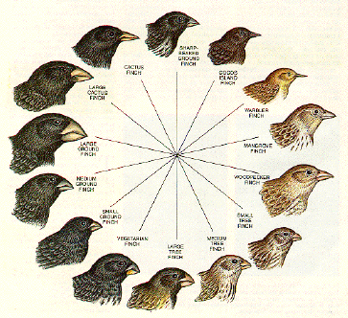

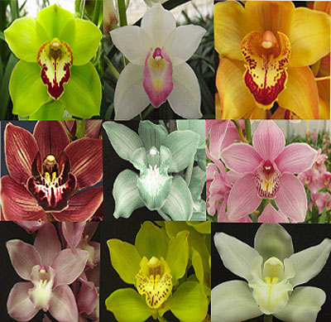
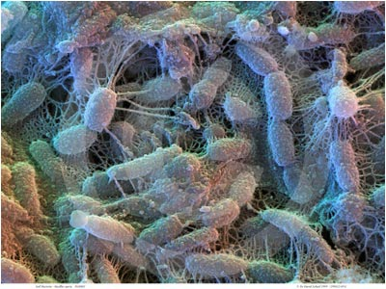



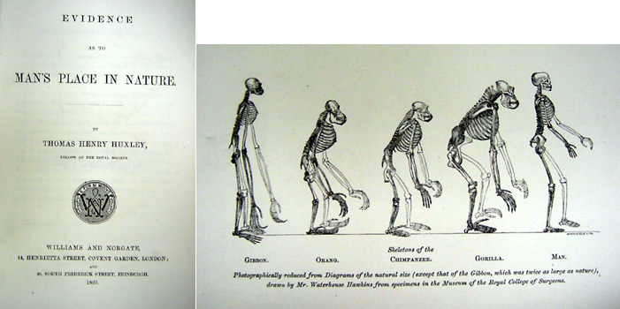
Why study natural selection
… from so simple a beginning endless forms most beautiful and most wonderful have been, and are being evolved.
Charles Darwin, 1859
On the Origin of Species by Means of Natural Selection
Notes:
The study of evolutionary patterns and natural selection in particular underpins the proposed project throughout.
Now that we have genomic data from a variety of organisms we can study the mechanisms that drive phenotypic change at the molecular level.
And it is at the molecular level that neutralist-selectionist debate arose questioning the relative significance of advantageous mutations compared to neutral mutations in shaping the genomes.

Slide 3
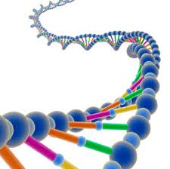
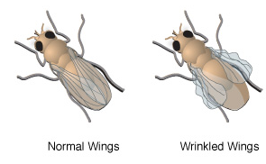
Big question of biology
How does genotype…
… shape phenotype?
Notes:
Now that we have genomic data from a variety of organisms we can study the mechanisms that drive phenotypic change at the molecular level.
DNA was first isolated by the Swiss physician Friedrich Miescher in 1869. As it resided in the nuclei of cells, he called it "nuclein".
In 1953, James Watson& Francis Crick suggested that the DNA is structured as a double-helix (based on Rosalind Franklin’s X-ray diffraction image).
With the discovery of the DNA we could start to compare genetic material across species (removing species boundary).

Slide 4
Evolutionary conservation means function
Genomic regions conserved across diverse species most likely have some functional significance

Slide 5
Conservation ↓ function
Percentage identity when human is aligned with another species.
Close species are effective in identifying regulatory elements while distant species are effective in identifying coding regions.
Thomas, et al. 2003. Nature

Slide 6
High variability may also mean functional significance, if the variability is driven by selection
Evolutionary biologists are more interested in positive selection because fixations of advantageous mutations in the genes or genomes are responsible for evolutionary innovations and species divergences.

Slide 7
There are two main explanations for genetic variation observed within a population or between species:
Natural selection (survival of the fittest) Mutation and drift (survival of the luckiest)
Gillespie, J.H. 1998. Population genetics: a concise guide. John Hopkins University Press, Baltimore.
Hartl, D.L., and A.G. Clark. 1997. Principles of population genetics. Sinauer Associates, Sunderland, Massachusetts.

Slide 8
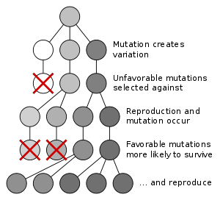
The neo-Darwinian theory of evolution
Natural selection shapes the genetic makeup
Most mutations are deleterious, removed by purifying selection
Substitutions ≠ polymorphisms
Substitutions are acquired by positive selection
Polymorphisms are kept by balancing selection
Notes:
Darwin proposed the theory of the evolution by natural selection without the knowledge of sources of variation in populations
Since mutation was shown to be the source of genetic variation, Darwinism and Mendelism were united in one framework, the “synthetic” theory of evolution or “neo-Darwinism”:
Natural selection shapes the genetic makeup of populations
Substitutions and polymorphism are two separate processes driven by different evolutionary forces
Gene substitutions occur through selection for advantageous mutations (adaptive process, new allele takes over as it increases fitness)
Polymorphism is maintained by balancing selection (coexistence of several alleles at a locus is advantageous for the organism/population)

Slide 9
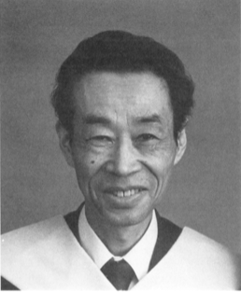

The neutral theory of molecular evolution
Motoo Kimura
Most mutations are deleterious
Most changes: random fixation of neutral mutations
The fate of alleles is determined by random genetic drift
Substitution rate = neutral mutation rate (molecular clock)
Selection may operate; but is too weak to influence
Substitution = polymorphism
Morphological traits evolve by natural selection
Notes:
Building upon work by Haldane, Dobzhansky, Fisher & Wright,
Motoo Kimura (1968; and independently King & Jukes 1969) proposed the neutral theory:
Majority of molecular changes in evolution are due to random fixation of neutral or nearly neutral mutations, and not caused by positive selection of advantageous alleles nor by balancing selection
The fate of alleles is largely determined by random genetic drift
Most mutations are deleterious and are removed by purifying selection
The nucleotide substitution rate = neutral mutation rate (explaining molecular clock hypothesis)
Selection may operate but is too weak to influence chance effects
Substitution and polymorphism are two facets of the same phenomenon (Kimura & Ota 1971)
Evolution of morphological traits is driven by natural selection

Slide 10
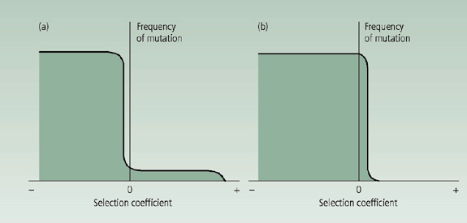
The impact of the neutral theory
The neutral theory makes simple and testable predictions about what we should observe: provided a falsifiable null hypothesis
Strengthened the connection between molecular biology and population genetics
Availability of such null hypothesis prompted the development of neutrality tests
s = selection coefficient
s describes relative fitness of
mutant a vs. wild-type A.
Genotype fitness:
1 for AA, 1+s for Aa, 1+2s for aa
s > 0 positive selection
s < 0 negative selection
Selectionism
Neutralism
From Ridley (1996) Evolution
Notes:
Both neutral theory and neo-Darwinism agree that most new mutations in protein are deleterious and are quickly removed from populations (so they don’t contribute to the rate of substitution or to the amount of polymorphism)
The disagreement concerns the proportion of neutral mutations among non-deleterious mutations and so the role selection plays at shaping the genomes
The neutral theory provided the molecular evolution field with a falsifiable null hypothesis (as neutral theory makes simple and testable predictions about what we should observe)
It also strengthened the connection between molecular biology and population genetics
Availability of such null hypothesis prompted the development of neutrality tests
Selectionists believe that exactly neutral mutations are rare and there are enough favorable mutations to account for all molecular evolution
Neutralists believe there are many more neutral, and hardly any selectively favored, mutations
Pan-neutralism is the theory claiming all mutations are selectively neutral

Slide 11
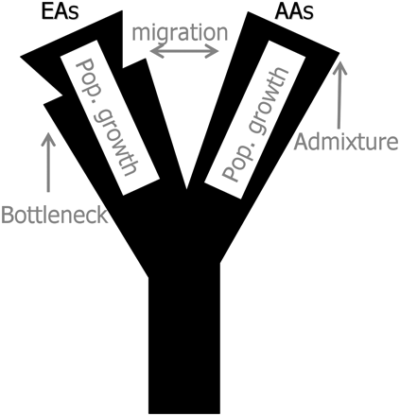
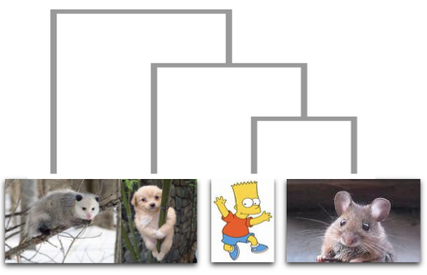
Neutrality and selection tests
Mutational frequency spectrum
(eg, Tajima’s D, Tajima 1989)
Population subdivision
LD & haplotype structure
Within/between species variability
(HKA test, Hudson, Kreitman, Aguade 1987)
Sensitive to demography
Account for codon structure:
Within/between species variability
(MK test, McDonald-Kreitman 1991)
Based on codon models
Notes:
Many selection tests have been developed and various statistical framework.
Population genetics tests of neutrality typically assume particular demographic model and therefore sensitive to such model.
Tests based on contrasting mutation or substitution patterns at synonymous and nonsynonymous sites are much more robust to demographic assumptions.
Codon models of evolution have been particularly successful, these are now a must in current genome papers.
These are most powerful for interspecific data and rely on a phylogeny.

Slide 12
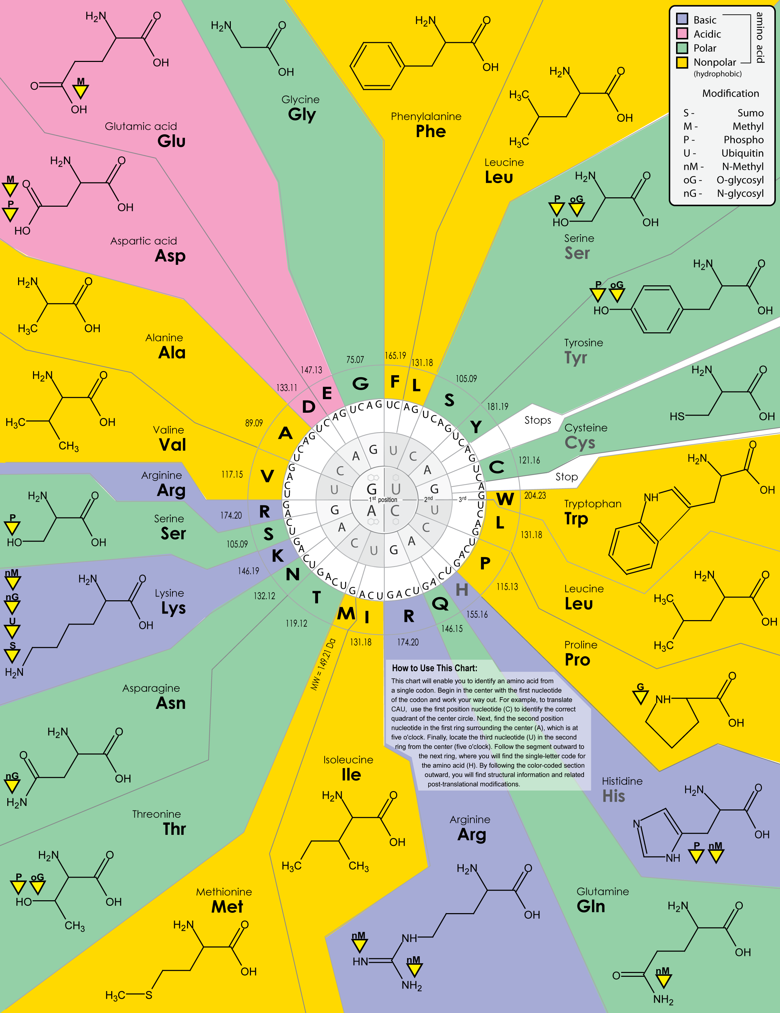
Standard
genetic code
The genetic code determines how random changes to the gene brought about by the process of mutation will impact the function of the encoded protein
Types of codon changes
Synonymous (silent):
TTC (Phe) → TTT (Phe)
Nonsynonymous:
TTC (Phe) → TTA (Leu)

Slide 13


Measuring selection on the protein
CTG ATA CCC CTC AGC
L I P L S
TTG ATA CGG CTC AGT
L I R L S
Ancestral sequence:
TTG ATA CGC CTC AGC
L I R L S
Synonymous rate = d_{S} (also K_{S})
Nonsynonymous rate = d_{N} (also K_{A})
ω = d_{N}/d_{S}
ω > 1 Positive selection
ω = 1 Neutral evolution
ω < 1 Negative selection
Notes:
(dN) dS: number of (non)synonymous substitutions per (non)synonymous site
d_{S} is the expected number of nt substitutions per nt site, averaged over 3 codon positions, before selection on the protein (i.e., had there be no selection on the protein)
d_{N} = d_{S} × ω

Slide 14
Why not counts but rates?
Example:
Pairwise alignment of 500 codons
Observed differences:
5 synonymous differences
5 nonsynonymous differences
Conclusion: Neutral evolution?
Hint: Need to know how many sites are synonymous and how many are nonsynonymous
Notes:
Consider amino acid mutations that occurred after the divergence of two species. If they are advantageous, they will spread into fixation and become fixed differences. If they are deleterious, they will be removed, resulting in a shortage of replacement fixed differences.

Slide 15
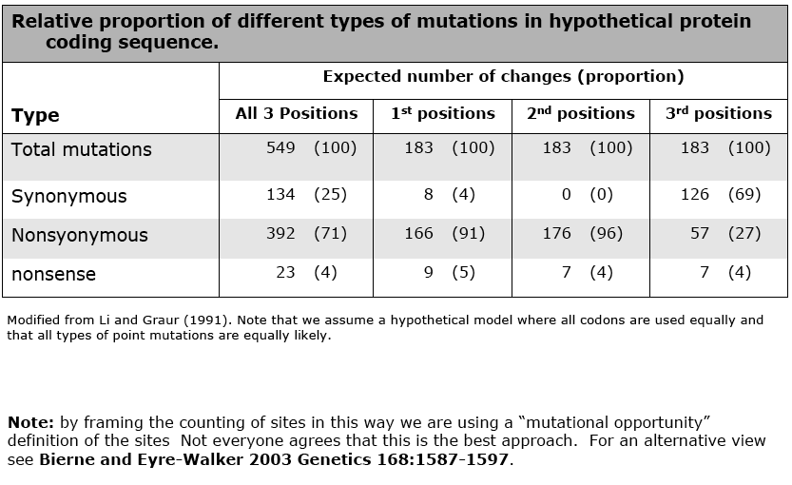
Evolution at the three codon positions
Notes:
Consider amino acid mutations that occurred after the divergence of two species. If they are advantageous, they will spread into fixation and become fixed differences. If they are deleterious, they will be removed, resulting in a shortage of replacement fixed differences.

Slide 16
Why not counts but rates?
Example:
Pairwise alignment of 500 codons (or 3x500 nt)
5 syn. differences, 25.5% syn. sites:
S = 500×3×25.5% = 382.5, so d_{S}=5/382.5 = 0.013
5 nonsyn. differences, 74.5% nonsyn. sites:
N = 500×3×74.5% = 1117.5, so d_{N} = 5/1117.5 = 0.0045
d_{N}/d_{S} = 0.0045/0.013 = 0.35 < 1
Conclusion: Purifying selection
Notes:
Consider amino acid mutations that occurred after the divergence of two species. If they are advantageous, they will spread into fixation and become fixed differences. If they are deleterious, they will be removed, resulting in a shortage of replacement fixed differences.

Slide 17


Pairwise estimation of dN and dS
Count synonymous and nonsynonymous sites (S and N)
Count synonymous and nonsynonymous differences
Calculate the proportion of differences, then d_{N} and d_{S}
Correct for multiple hits
CTG ATA CCC CTC AGC
TTA ATA CCC CTC AGC
CTG ATA TGT CTA GGA

Slide 18
Counting sites (S and N)
TTG (Leu)
TTA (Leu)
1/3 synonymous sites
8/3 nonsynonymous sites
TTC (Phe)
TCT (Ser)
TTT (Phe)
TAT (Tyr)
GTT (Val)
TGT (Cys)
ATT (Ile)
CTT (Leu)
Sites are defined as mutational opportunities
Notes:
Purines: A, G
Pyrimidines: C, T

Slide 19
Counting differences
How many differences between CCT and CAG?
Pathways between CCT and CAG Syn Nonsyn
CCT (Pro) ↔ CAT (His) ↔ CAG (Gln) 0 2
CCT (Pro) ↔ CCG (Pro) ↔ CAG (Gln) 1 1
Average 0.5 1.5

Slide 20
The impact of κ
At 3d positions, transitions are
more likely to be synonymous than transversions
0.34
0.32
0.3
0.28
0.26
0.24
0.22
0.2
0
5
10
15
20
Transition/transversion rate ratio (κ = α/β)
Notes:
Observation from the genetic code

Slide 21
Codon usage bias
Analysis of real genes suggests that codon usage bias leads to reduced number of synonymous sites
(the opposite effect to the κ bias)

Slide 22
Correcting for multiple hits
Ad hoc correction using DNA models, which assume that a nonsynonymous site has equal rate of changing into 3 other nonsynonymous nucleotides (Lewontin 1989).

Slide 23
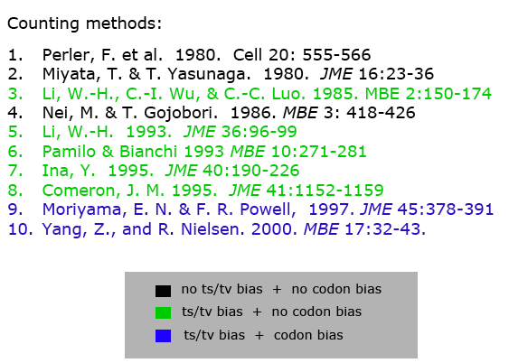
Numerous counting methods
of increasing sophistication
Notes:
The counting methods are safe to use if codon usage (especially at the 3rd position) is uniform, the sequences are not very divergent, and transition and transversion rates are similar (NG86).

Slide 24
Human & orangutan α2-globin genes: 142 codons
Method/Model
κ
S
N
d
N
d
d
/
d
S
N
S
NG86
1
109.4
316.6
0.0095
0.0569
0.168
Ina95
2.1
119.3
299.9
0.0101
0.0523
0.193
YN00
6.1
61.7
367.3
0.0083
0.1065
0.078
ML (GY94)
(1) ML Fequal,
κ
= 1
1
108.5
317.5
0.0093
0.0557
0.167
(2) ML Fequal,
κ
estimat
ed
3.0
124.6
301.4
0.0099
0.0480
0.206
(7) ML F61,
κ
= 1 fixed
1
58.3
367.7
0.0082
0.1145
0.072
(8) ML F61,
κ
estimated
5.3
55.3
370.7
0.0082
0.1237
0.066
Base frequencies at 3rd position: T = 9%, C = 52%, A = 1%, G = 37%
(Yang & Bielawski 2000. TREE 15:496-503)
Notes:
Assumptions matter more than models.
The counting methods are safe to use if codon usage (especially at the 3rd position) is uniform, the sequences are not very divergent, and transition and transversion rates are similar (NG86).

Slide 25
Software
Methods | Software
Counting methods NG86 Li93 Comeron 95 YN00 | MEGA; codeml & yn00 in PAML MEGA, DAMBE, codeml DIVERGE by Comeron yn00 in PAML
ML methods
GY94 | codeml

Slide 26
Detecting selection based on 
From pairwise comparisons
Best known examples:
Adaptation in primate lysozyme (Messier & Stewart 1997)
Adaptation in human MHC (Hughes & Nei 1988)
From MSAs using underlying phylogeny
° Using ancestral reconstruction and counting at each site
(HA gene from flu, Fitch et al. 1997, Suzuki & Gojobori 1999)
° Markov models of codon evolution detect positive selection
at individual sites in the protein
in individual lineages
at individual sites & lineages (episodic selection)
Notes:
The major histocompatibility complex (MHC) is a set of cell surface molecules encoded by a large gene family which controls a major part of the immune system in all vertebrates. The major function of MHCs is to bind to peptide fragments derived from pathogens and display them on the cell surface for recognition by the appropriate T-cells.

Slide 27
Types of codon substitution models
Branch models to test positive selection on lineages on the tree (Yang 1998. Mol. Biol. Evol. 15:568-573)
Site models to test positive selection affecting individual sites (Nielsen & Yang. 1998. Genetics 148:929-936;
Yang, et al. 2000. Genetics 155:431-449)
Branch-site models to detect positive selection at a few sites on a particular lineage (Yang & Nielsen. 2002. Mol. Biol. Evol. 19:908-917; Yang, et al. 2005. Mol. Biol. Evol. 22:1107-1118)

Slide 28
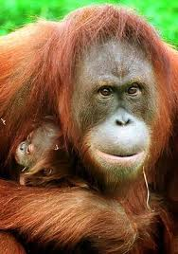
Measuring selection on the protein
CTG ATA CCC CTC AGC
L I P L S
TTA ATA CCC CTC AGC
L I P L S
TTG ATA CGG CTC AGT
L I R L S
TTA ATA TGG CTC AGC
L I W L S
CTG ATA TGT CTA GGA
L I C L G
synonymous rate: d_{S} nonsynonymous rate: d_{N}
ω = d_{N}/d_{S} > 1 positive selection
ω < 1 negative selection

Slide 29
Why Markov codon models
Take phylogeny into account
Estimate evolutionary parameters
Correct for multiple hits
Account for all possible evolutionary pathways between codons and weight them based on a model

Slide 30
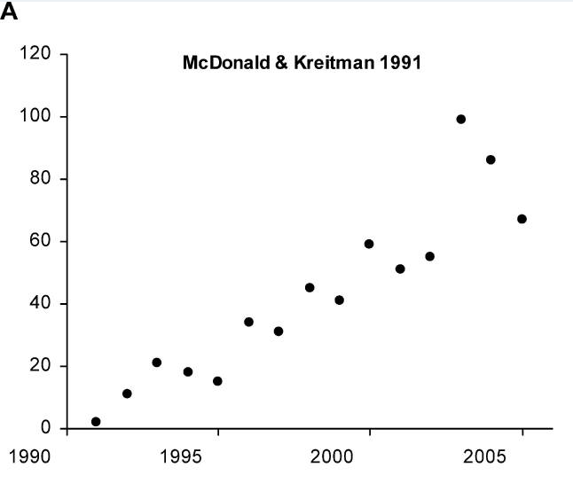
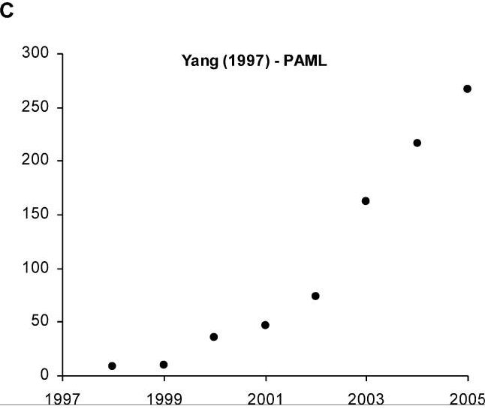
Markov codon models: a success story
Rigorous statistical framework for hypothesis testing
Explicitly incorporates evolutionary parameters
Extensively tested in simulation and on real data:
Low false positive rate
Much more powerful tests
(eg, Anisimova et al. 2001, 2002, 2003; Anisimova & Yang 2007)

Slide 31


Markov model of codon evolution
Instantaneous substitution matrix Q ={q_{ij}}:
ω = d_{N}/d_{S} (selection on protein)
κ = transition/transversion ratio
π_{j} = frequency of codon j
f_{x}^{p} = frequency of nucleotide x at codon position p
Notes:
Its has been shown (also in my publication) that codon model based approach was the most accurate and powerful to detect positive selection

Slide 32
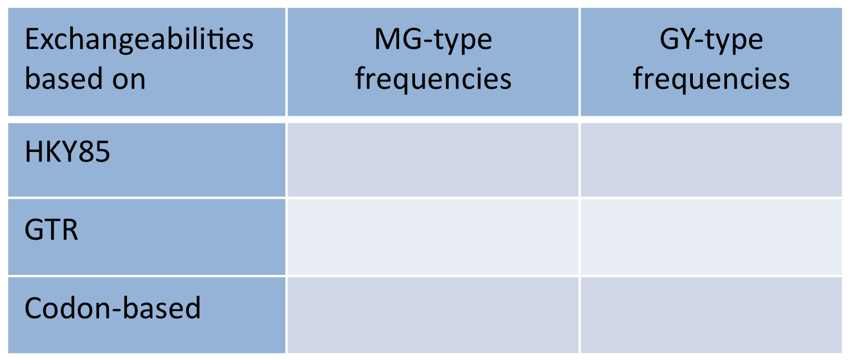
Defining instantaneous rates
There are many ways to define instantaneous rates:
His
C
A
T
Ser
A
A
T
Notes:
Its has been shown (also in my publication) that codon model based approach was the most accurate and powerful to detect positive selection

Slide 33
Modeling codon frequencies
All codon models assume reversibility and stationarity
Codon frequencies {π_{j}} are the same at any time
Model
Fequal | 1/61 | 1/61
F1x4
F3x4
F61
His
C
A
T
Ser
A
A
T
Notes:
Its has been shown (also in my publication) that codon model based approach was the most accurate and powerful to detect positive selection

Slide 34
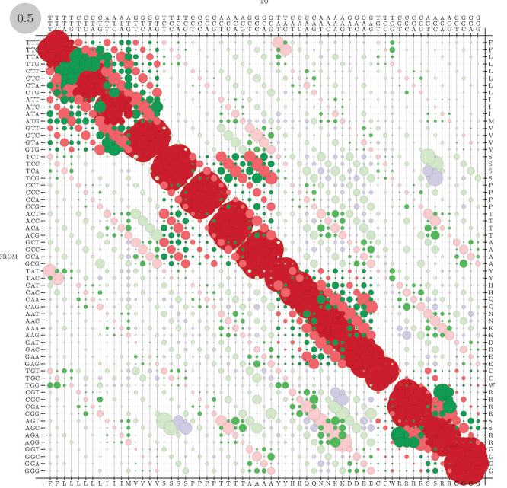
Likelihood function over phylogeny
Transition probability matrix over time t: P(t) = e^{Qt}
Using P(t) a likelihood L(Data) can be constructed:
Parameters optimized by maximum likelihood
Pr( | )
Data
Model
Tree with
branch lengths
Notes:
ML has nice statistical properties but this can also be done using Bayesian inference (an option we will explore).

Slide 35
Likelihood function over phylogeny
For each site compute the likelihood:
R
Compute total likelihood assuming
independent & identical distribution (i.i.d.) for all sites:
t₄
N
t₃
t₁
t₂
Log-likelihood is optimized (for convenience):
CCT
CAT
CAG
Unrooted tree – arbitrary root

Slide 36
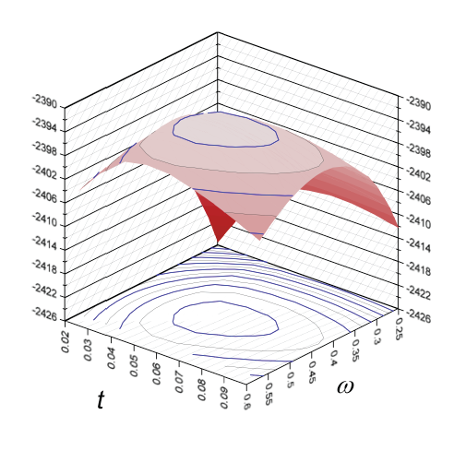
ML parameter estimation
lnL =-2399
Numerical optimization by hill-climbing
Example ML estimation
for acetylcholine α receptor from human and mouse
Notes:
ML has nice statistical properties but this can also be done using Bayesian inference (an option we will explore).
MLEs of t and ω ➔ MLEs of d_{S} and d_{N} (κ =1 fixed)

Slide 37
Exercises with codeml
Focus:
ML estimation with one ω-ratio model M0
Notes:
ML has nice statistical properties but this can also be done using Bayesian inference (an option we will explore).
MLEs of t and ω ➔ MLEs of d_{S} and d_{N} (κ =1 fixed)

Slide 38
Likelihood ratio test for positive selection
Consider two nested models:
Model 0 no positive selection
(H0:  is always ≤1)
Model 1 allows positive selection
(H1:  >1 for some sites or in certain lineages)
LRT statistic:
d.f. = difference in numbers of parameters
Notes:
Its has been shown (also in my publication) that codon model based approach was the most accurate and powerful to detect positive selection

Slide 39
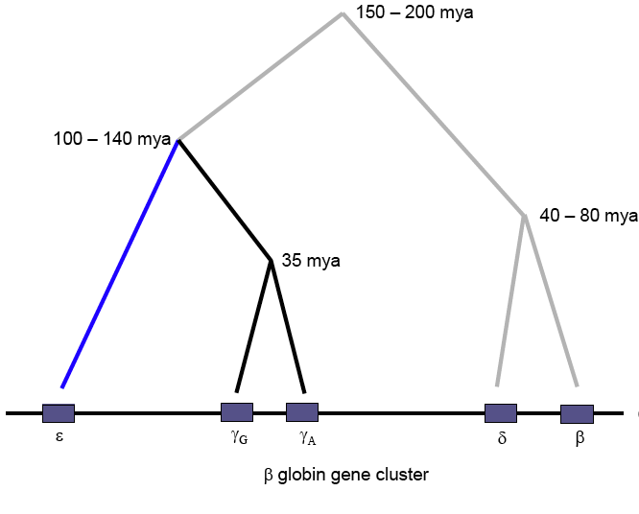
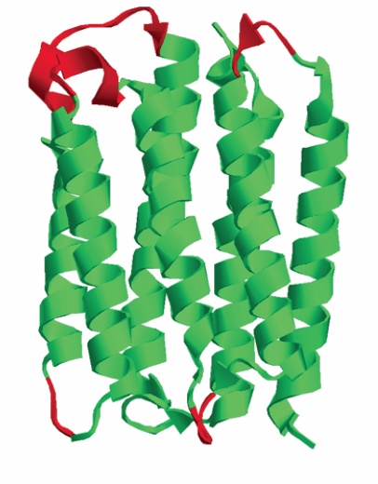
Modeling selection variability
Assuming constant selective pressure across the whole sequence and over the whole phylogeny renders the power of the test low
e.g., Endo et al (1996) detected only 17 out of 3595 analyzed genes to be under selection
Positive selection usually affects:
only in a few lineages/branches only few codon sites
Notes:
Its has been shown (also in my publication) that codon model based approach was the most accurate and powerful to detect positive selection
Green is some transmembrane protein where loops are not under strong structural constraints and are allowed to vary more.

Slide 40
Modeling selection variability
By modeling variable ω over time and across sites
we can study:
WHEN (in which lineages) did positive selection occur?
WHERE in the sequence did positive selection occur?
Notes:
Its has been shown (also in my publication) that codon model based approach was the most accurate and powerful to detect positive selection

Slide 41
Modeling variability over time
Assign independent ω parameters to different branches on the tree:
R
t₄
ω₀
N
t₃
t₁
t₂
ω₀
ω_{chimp}
ω₀
CCT
CAT
CAG
Notes:
Its has been shown (also in my publication) that codon model based approach was the most accurate and powerful to detect positive selection

Slide 42
Modeling variability over time
Assign independent ω parameters to different branches on the tree:
R
t₄
ω₄
N
t₃
t₁
t₂
ω₁
ω₂
ω₃
CCT
CAT
CAG
Notes:
Its has been shown (also in my publication) that codon model based approach was the most accurate and powerful to detect positive selection

Slide 43


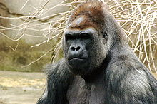
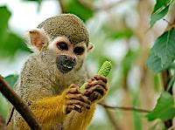

Adaptive evolution in primate lyzozyme:
ω variability over time
Data: Messier & Stewart (1997)
Re-analysis: Yang (1998)
Douc langur
Dusky langur
ω_{C}
Francois' Langur
Hanuman langur
Purple-faced langur
ω₀
Proboscis monkey
Guereza colobus
Colobines
Angolan colobus
Patas monkey
Vervet
Cercopithecines
Talapoin
Allen's monkey
Olive baboon
Sooty mangabey
ω_{H}
Rhesus macaque
Lar gibbon
Human
chimpanzee, bonobo, gorilla
Orangutan
Hominoids
Squirrel monkey
Tamarin
Marmoset
New World monkeys
Notes:
Adaptive replacements were found to contribute to a better performance at a low pH and confer protection against the proteolytic (breaking-down) activities of the stomach

Slide 44
Primate lyzozyme: ML estimates
Model | p | ● | ω₀ | ω_{C}
A. 1-ratio: ω₀=ω_{C} | 35 | –1043.84 | 0.574 | = ω₀
B. 2-ratios: ω₀, ω_{C} | 36 | –1041.70 | 0.489 | 3.383
C. 2-ratios: ω₀, ω_{C}=1 | 35 | –1042.50 | 0.488 | 1 (fixed)
LRT
Null hypothesis | 2∆ | d.f.
ω_{C} = ω₀ | 4.24* | 1
ω_{C} = 1 | 1.60 | 1
Estimates from Yang (1998)

Slide 45
Free ω-ratio LRT with branch model
H₀: one ω for all branches
H₁: different ω for each branch

Slide 46
Free ω-ratio LRT with branch model
H₀: one ω for all branches
H₁: different ω for each branch
#branches (for unrooted
tree with T leaves):
2T-3
d.f. = (2T-3) - 1 = 2T- 4
Here: d.f. = 8

Slide 47
Exercises with codeml
Focus:
ML estimation with branch models
Notes:
ML has nice statistical properties but this can also be done using Bayesian inference (an option we will explore).
MLEs of t and ω ➔ MLEs of d_{S} and d_{N} (κ =1 fixed)

Slide 48
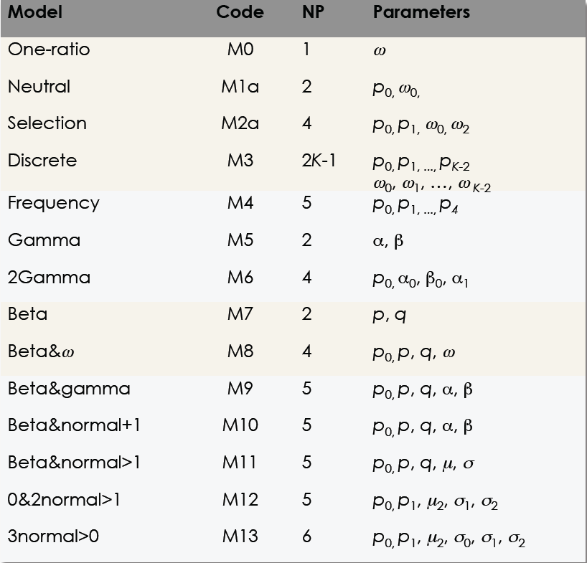
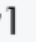
Modeling ω variability across sites
M-series models vary only by distributions used to model ω
Yang et al. (2000), MBE
It is hard to say what distribution shapes better reflects the data
Notes:
Its has been shown (also in my publication) that codon model based approach was the most accurate and powerful to detect positive selection

Slide 49
Examples of nested site models
0.8
0.8
M2
M1
0.6
0.6
0.4
p₀
p₁
0.4
p₀
p₁
p₂
0.2
0.2
0
0
ω₀<1
ω₁=1
ω₂>1
ω₀<1
ω₁=1
0.2
1
4
0.2
1
M8
0.6
0.6
M7
0.4
0.4
p₀
0.2
p₁
0.2
0
0
ω ~ B(p,q)
ω>1
ω ~ B(p,q)
0.1
1.0
4.0
0.1
1.0
Alternative
Null
0 ≤ B(p,q) ≤ 1
Notes:
Each LRT has 2 parameters difference, but for M1 vs M2 the test is conservative.

Slide 50
beta(0.2, 0.2)
beta(0.2, 1)
beta(0.2, 2)
beta(1, 0.2)
beta(1, 1)
beta(1, 2)
beta(2, 0.2)
beta(2, 1)
beta(2, 2)

Slide 51
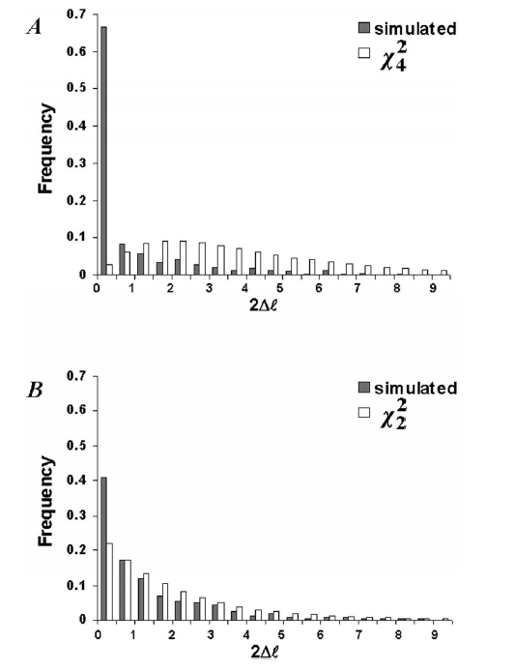
Theoretical distribution of LRT
M0 vs. M3 (with 3 classes)
Transition from M3 to M0 requires
p₀ = p₁ = 0 (boundary)
Theoretical distribution makes the test conservative
M7 vs. M8
Transition from M8 to M7 requires
sets p₀ = 1 (or p₁ = 0, both at the boundary)
Theoretical distribution fits better than in A (slightly conservative)
Anisimova et al. (2001), MBE

Slide 52
Examples of nested site models
A better defined LRT:
The null is 50:50 Χ²mixture (with d.f. = 1 and 0)
M8
0.6
0.6
M8a
0.4
0.4
p₀
p₀
0.2
p₁
0.2
p₁
0
0
ω ~ B(p,q)
ω≥1
ω ~ B(p,q)
ω=1
0.1
1.0
4.0
0.1
0.1
1.0
4.0
1.0
Alternative
Null
Notes:
under the null hypothesis, one of the parameters is on the boundary of the parameter space and another parameter is not estimable. The use of two degrees of freedom is therefore an approximation that results in a conservative test. Another problem is that test I may result in a high proportion of significant tests even when there is no positive selection if the beta-distribution provides a poor fit to the true distribution of ω in the interval (0, 1). For example, if much of the probability mass is located around ω = 0.5 and ω = 1.0, M8 may provide a significantly better fit to data than M7, with an estimate of ω_{s} > 1 with probability 0.5, although no positive selection occurs.
Pervasive Adaptive Evolution in Mammalian Fertilization Proteins
Willie J. Swanson * † , Rasmus Nielsen ‡ and Qiaofeng Yang †

Slide 53
Examples of nested site-specific models
0.8
M2
0.6
0.4
p₀
p₁
p₂
0.2
0
ω₀<1
ω₁=1
ω₂>1
0.2
1
4
Likelihood calculation should take into account
that a site may come from a number of different classes:

Slide 54
Example: Human MHC Class I data
192 alleles, 270 codons
Model  Parameter estimates
M1a (neutral) −7,490.99 p₀ = 0.830, ω₀ = 0.041 p₁ = 0.170, ω₁ = 1
M2a (selection) −7,231.15 p₀ = 0.776, ω₀ = 0.058
p₁ = 0.140, ω₁ = 1
p₂ = 0.084, ω₂ = 5.389
LRT of positive selection: 2Δ = 2 × 259.84 = 519.68, P < 0.000 (d.f. = 2)
Yang and Swanson (2002) MBE

Slide 55
So far we used
models with variable selection
to test if selection affected the data
If LRT for positive selection is significant
we can proceed inferring WHEN and WHERE…
(but this is more difficult)

Slide 56
Prediction of sites with Bayesian approach
ω site classes (GDD or M3):
For each site compute posterior probability:
Sites with high posteriors (≥0.95)
may be inferred to be under positive selection
60%
10%
30%
ω=0.1 ω=1 ω =4.3
CTC
TTA
TTG
TTA
CTG
P( | )P( )
CTC
TTA
TTG
TTA
CTG
P( | ) =
P( | )P( )+ P( | )P( )+ P( | )P( )
CTC
TTA
TTG
TTA
CTG
CTC
TTA
TTG
TTA
CTG
CTC
TTA
TTG
TTA
CTG

Slide 57
Empirical Bayesian calculation of posterior probabilities that a site is under positive selection with ω > 1.
Naïve Empirical Bayes (NEB) ignores sampling errors in parameter estimates.
Bayes Empirical Bayes (BEB) accounts for sampling errors by integrating over a prior.
Nielsen & Yang. 1998 Genetics 148
Yang, Wong & Nielsen 2005 Mol Biol Evol 22

Slide 58
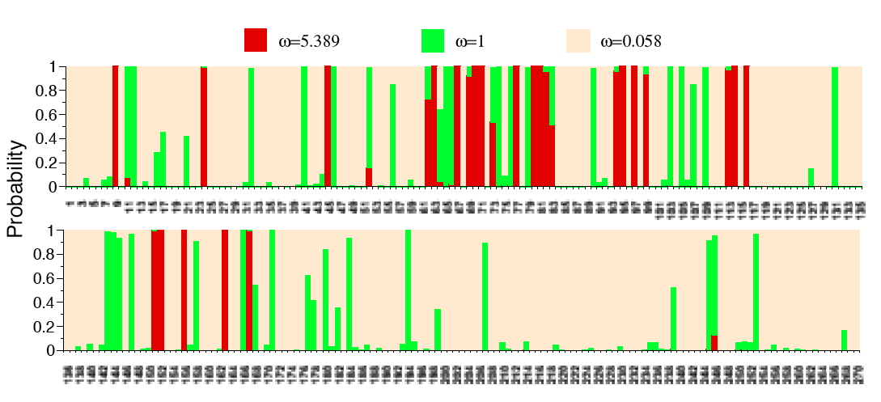
Posterior probabilities of  for MHC (M2a)

Slide 59
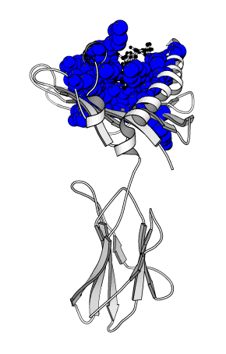
25 sites identified under M2a All sites cluster together in the antigen recognition domain (blue) Yang and Swanson (2002)
Human MHC Class I: 3D structure

Slide 60
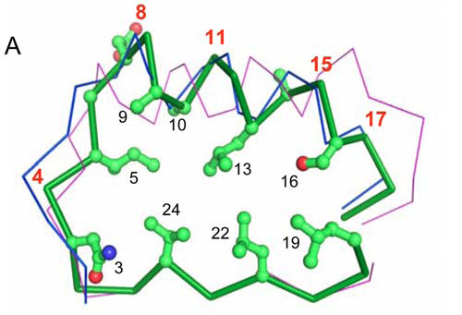
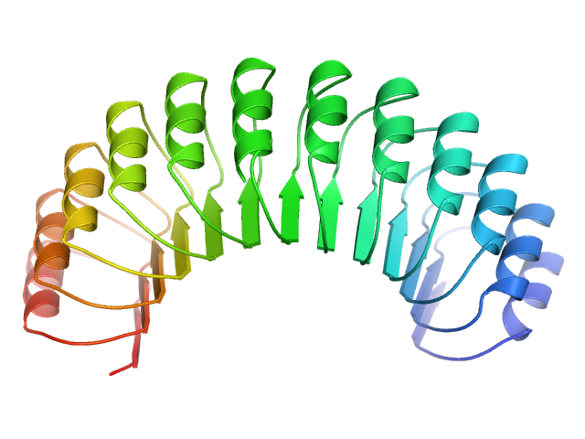
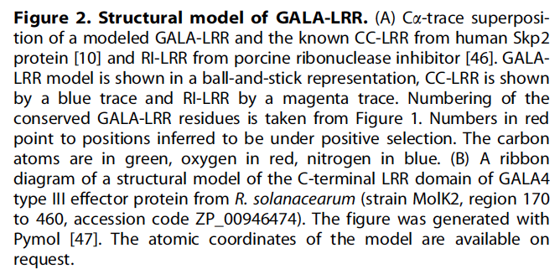
Positive selection in bacterial GALA
Bacterial GALA (type III effectors) acquired from host plants by LGT: residues under positive selection are found on the convex side of horse-shoe & involved in binding
Data from Kajava, Anisimova, Peeters (2008)
B
Notes:
(c) Type III effector proteins are determinants of virulence on susceptible plant hosts; they are also the proteins that trigger specific disease resistance in resistant plant hosts. Evolution of type III effectors is dominated by competing forces: the likely requirement for conservation of virulence function, the avoidance of host defenses, and possible adaptation to new hosts.

Slide 61
With more genomes sequenced, the approach of evolutionary comparison becomes more powerful.
It provides a way of generating interesting biological hypotheses, which can be validated by experimentation.
Ivarsson, Mackey, Edalat, Pearson, and Mannervik (2002) Identification of residues in glutathione transferase capable of driving functional diversification in evolution: a novel approach to protein design. J. Biol. Chem. 278:8733-8738.
Bielawski, Dunn, Sabehi, and Beja (2004) Darwinian adaptation of proteorhodopsin to different light intensities in the marine environment. Proc. Natl. Acad. Sci. U.S.A. 101:14824-14829.

Slide 62
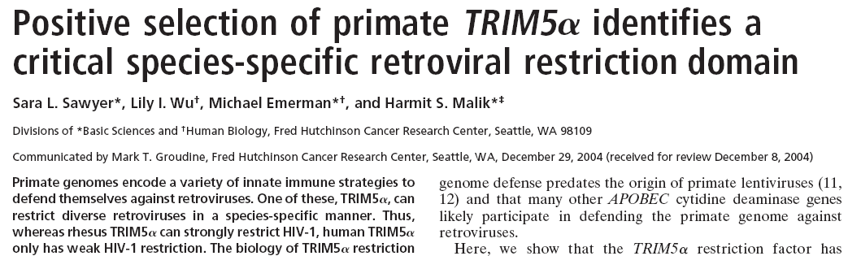
Rhesus TRIM5 restricts HIV-1 while human TRIM5 has only weak restriction.
Phylogenetic analysis identified a 13-aa patch with many positive-selected sites. Functional studies of chimeric TRIM5 genes demonstrated that the patch was largely responsible for the difference in function. (Sawyer et al 2005)

Slide 63
Exercises with codeml
Focus:
ML estimation with site models
Notes:
ML has nice statistical properties but this can also be done using Bayesian inference (an option we will explore).
MLEs of t and ω ➔ MLEs of d_{S} and d_{N} (κ =1 fixed)

Slide 64
Branch-site codon model A (Yang et al 2005)
Neutral class
p1
ω0 < 1
ω1 = 1
Conserved class
p0
ω1 = 1
ω0 < 1
ω2 ≥ 1
ω2 ≥ 1
Variable class 1 p0(1-p0-p1)/(p0+p1)
Variable class 2 p1(1-p0-p1)/(p0+p1)

Slide 65
LRT for positive selection
based on branch-site codon model
Alternative: Model A ω₂ ≥ 1 estimated ₁
Null: Model A ω₂ = 1 fixed ₀
LRT statistic 2(₀ − ₁) ~
Foreground branches (with ω₂) are defined a priori

Slide 66
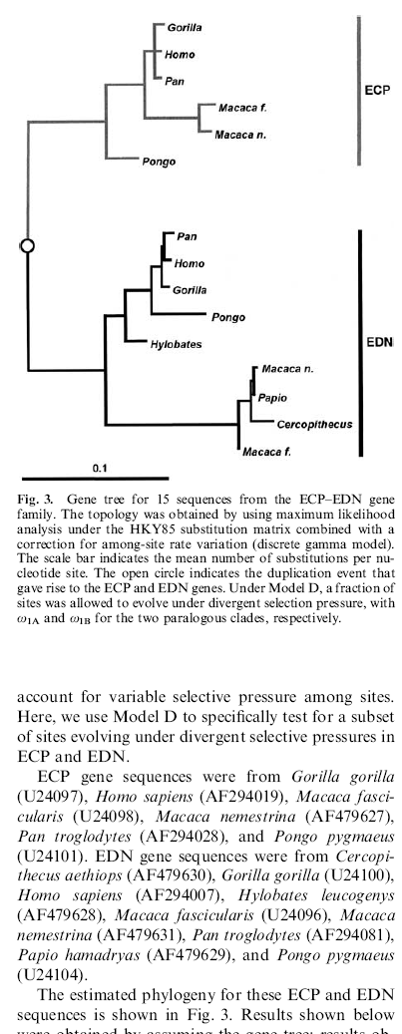
To test for selection
after gene duplication:
branches of one clade following the duplication event are set as foreground
Figure from Bielawski and Yang (2004)

Slide 67
Testing multiple hypotheses
Test one branch at a time?
H4
H3
Anisimova & Yang (2007), MBE
H5
H1
H2
Are p₁, p₂, p₃, p₄, p₅ significant at an overall threshold α?
Adjust individual thresholds α₁, α₂, α₃, α₄, α₅
so overall type I error rate ≤ α

Slide 68
Multiple testing correction: FWER or FDR?
Family-Wise Error Rate (FWER): overall type I error (FP rate) FWER = Pr (reject at least one null when it’s true) For n independent true null hypotheses tested at α: FWER= 1 – (1 – α)^{n} e.g. testing 10 hypotheses at 5% each we may get FWER=40%!
If in some cases the null hypotheses is expected to be wrong, small percentage of false rejections is tolerable FDR = False Discovery Rate FDR = E(# false rejections/# all rejections)

Slide 69
Example: how do FWER and FDR compare
100 simulated datasets with first 6 null hypotheses true
For each sample, test 10 hypotheses, making 1 error per sample
Test results: 1=sign / 0=not sign
1 0 0 0 0 0 1 1 1 1 1
2 0 1 0 0 0 0 1 1 1 1
3 0 0 0 0 1 0 1 1 1 1
…
100 0 1 0 0 0 0 1 1 1 1
T T T T T T F F F F
FDR = 20%
FWER = 100%

Slide 70
Multiple branch-site LRTs example:
CD2 extra-cellular domain
1
Multiple LRTs
Anisimova &Yang 2007
0.8
Free-ratio model
Lynn et al. 2005
Rat
Rat
1
0.5
Mouse
Mouse
5.8
1.2
Horse
Horse
∞
6.6
1
1.9
Cat
Cat
2.7
Pig
1.3
1
28
Pig
7.6
11.1
Cow
1.2
2.6
0.5
Cow
1
Rh Monkey
0.4
Rh Monkey
Baboon 1
Baboon
38.6
Human
1.9
Human
1
0.4
0.1
Chimp
0.1
Chimp
Notes:
We analyzed extracellular domain of the cluster of differentiation 2 (CD2) gene from 10 mammalian species

Slide 71
All but two sites under positive selection are found in the extra-cellular domain of CD2

Slide 72
Alternatively, use covarion models
Seq1 TCTTTATTGACGTGTATGGACAATTC
Seq2 TCTTTGTTAACGTGCATGGACAATTC
Seq3 TCCTTGCTAACATGCATGGACAATTC
Seq4 TCTTTGCTAACGTGCATGGATAATTC
Seq5 TCTT−−−TAACGTGCATAGATAACTC
Seq6 TCAC−−−TAACATGTATAGATAACTC
Seq7 TCTCTTCTAACGTGCATTGTGAAGTC
Seq8 TCTCTTTTGACATGTATTGAAAAATC
A
C
G
T
A
C
G
T
A
C
G
T
A
A
A
C
C
C
Figure by Simon Whelan
G
G
G
T
T
T
Rate = 0.5
Rate = 1.0
Rate = 2.0
Notes:
Switching between models to model heterogeneity of evolution over time & sites

Slide 73
A
C
G
T
T T C G T A
A
C
G
T
Rate = 0.5
A
C
G
T
A
C
Time
G
T
Rate = 1.0
A
C
G
T
A
C
G
T
Slide by Simon Whelan
Rate = 2.0
Notes:
Each site has different history

Slide 74
Markov Modulated Codon Model
Guindon et el. 2004 PNAS
Q_{x} describes instanteneous rates for sites from selection regime x
Codon models M2 and M3 are considered (each has 3 classes of sites)
R describes rate switches between selection regimes 1, 2 and 3 (ω₁< ω ₂< ω ₃ )
p₁, p₂, p₃ are equilibrium frequencies of sites in each selection regime (add up to 1)
α is relative rate of changes between 1 and 3
β is relative rate of changes between 2 and 3
Combined process:
δ is the rate of switch between selection regimes
Notes:
a covarion-like model for variation of selective pressure over time and among-sites.
Parameters were estimated by ML.

Slide 75
Markov Modulated Codon Model
Notes:
a covarion-like model for variation of selective pressure over time and among-sites.
Parameters were estimated by ML.

Slide 76
LRTs of temporal variation in selection
H₀: δ = 0 (no switches btw regimes or M3)
H₁: δ ≠ 0
H₀: δ = 0 (no switches btw regimes)
H₁: β = α = 1 (switching but no bias in switching pattern)
H₀: β = α = 1 (no bias in switching pattern)
H₁: β ≠ α
Model notations: +S1 (β = α = 1)
+S2 (β = α are free)
Notes:
1. Null distribution: 50:50 mixture of χ² with d.f.= 2 and 3
[this distribution may not hold as β and α become inestimable]
2. Null distribution: 50:50 mixture of χ² with d.f.= 0 and 1
3. Null distribution: χ² with d.f.= 2

Slide 77
LRTs of temporal variation in selection
Guindon et el. 2004 PNAS
Significant at 5%

Slide 78
For each site, the expected time spent in selection class z on the branch of length T, which had selection regime x at the start and y at the end:
This approach is used to detect sites in the alignment where positive selection is likely to have occurred in most of the lineages
…
Guindon et el. 2004 PNAS

Slide 79
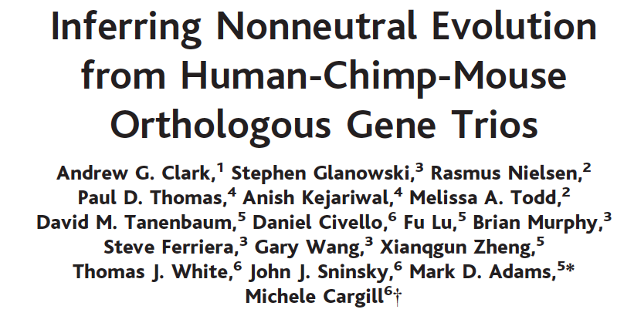
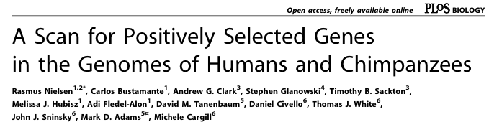
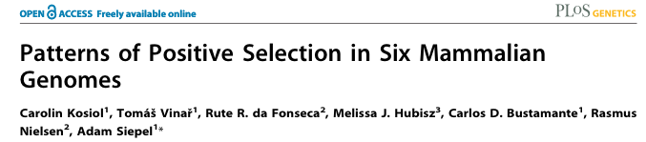

Two decades of large-scale selection scans
2005
2003, Science
2008
2006
Notes:
Large-scale scans became a standard task for the publication of new genomes

Slide 80
Large-scale selection scans step-by-step
DNA CDs library
AA library
CDs from complete genomes /databases
MSAs (both AA and CDs)
Homologous gene clusters (unaligned AA data)
Statistical
analysis
0.236251 9929 1.1542 0.00012 1.1542 0.03029 1.1542 0.03029
0.6767251 9945 1.1542 0.03029 1.1542 0.03029
0.1111251 9981 1.1542 0.01998 0.1111251 9981
0.230004 9139 1.1542 0.00912 0.1111251 9981 1.1542 ..
What do we do with all these numbers?

Slide 81
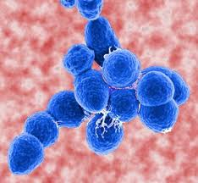
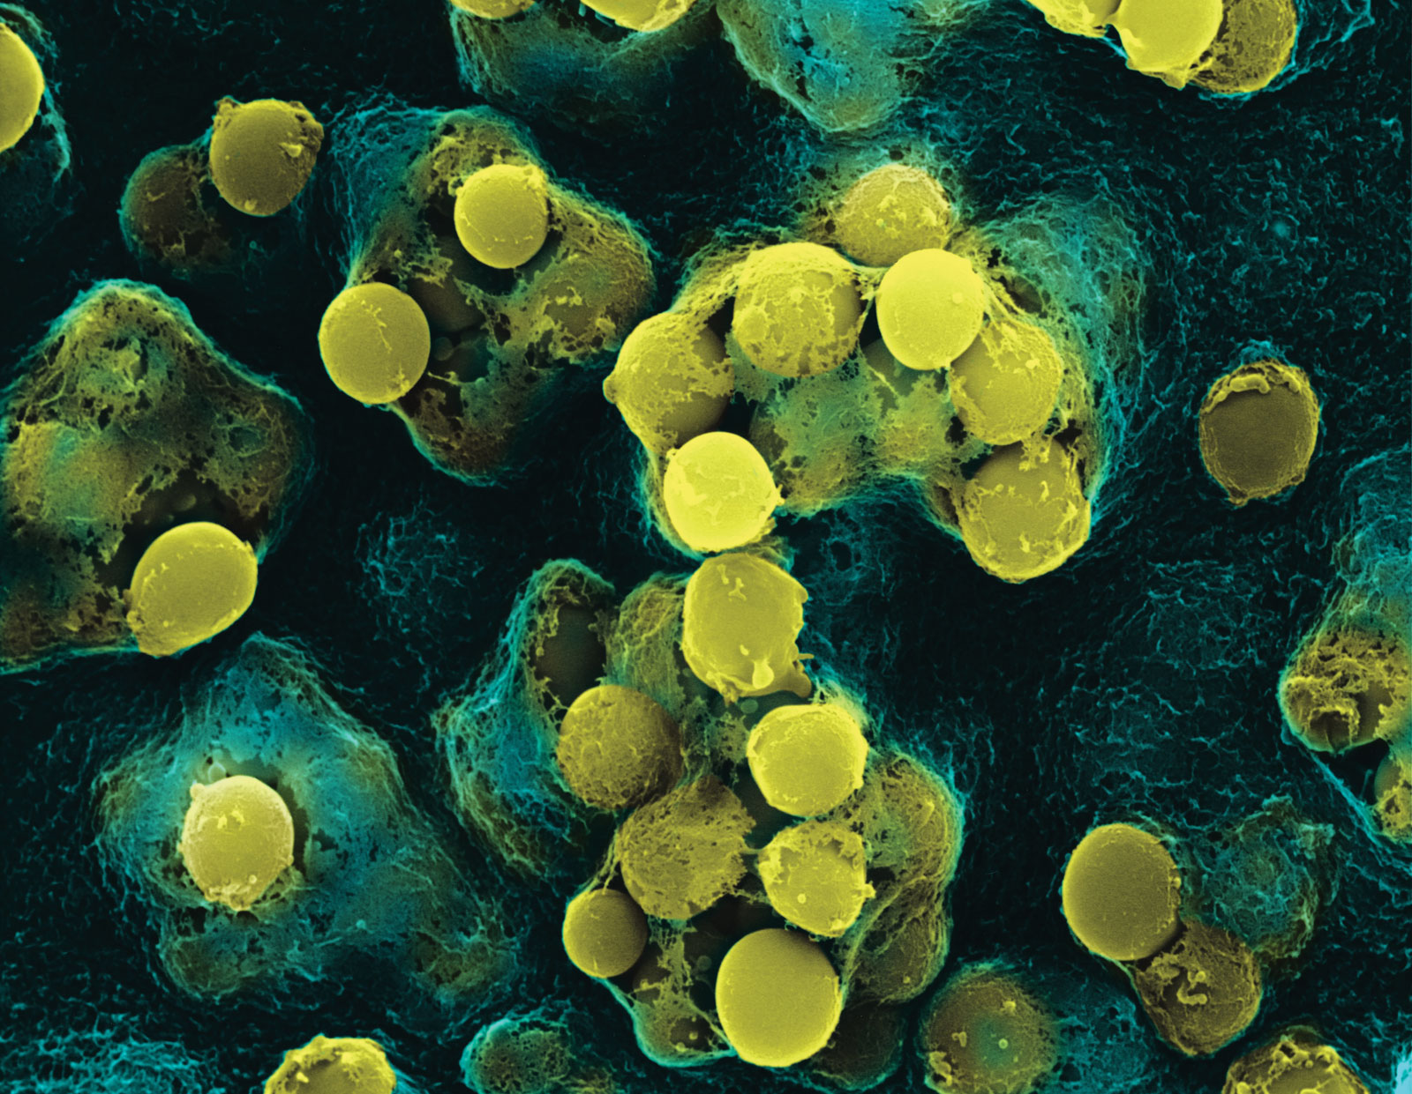
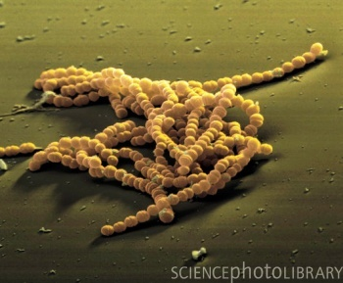
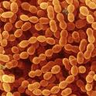
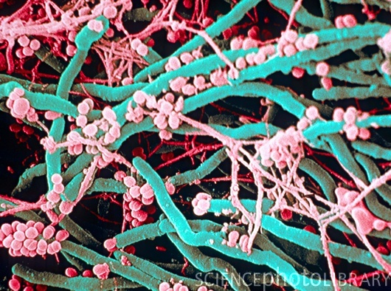
Anisimova et al 2007 BMC Evol Biol 12 complete genomes Positive selection in 136 genes: 29% connected to virulence 10% no ascribable function 7% essential to S. pneumoniae 19% with body-site specific patterns of gene expression during invasive disease in S. pyogenes (infected blood, cerebrospinal fluid, epithelial cell contact)
Natural selection in Streptococcus
S. pyogenes
S. pneumoniae
S. agalactiae
S. thermophilus
0.1
S. mutans
Positive selection affects both core and accessory genes,
most likely due to the antagonistic interaction between host and parasite.
Products of both core and auxiliary genes participate in complex networks that comprise the molecular basis of virulence.

Slide 82
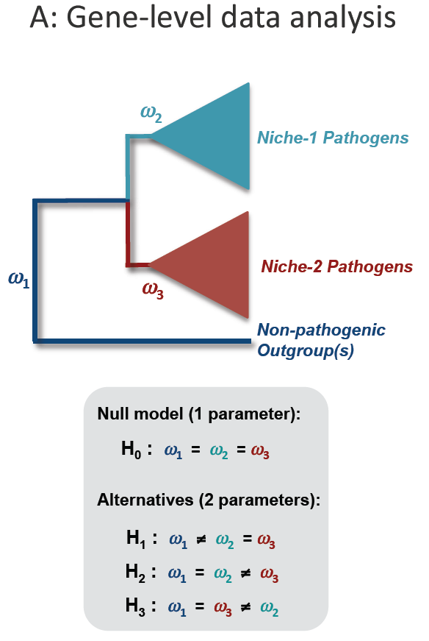
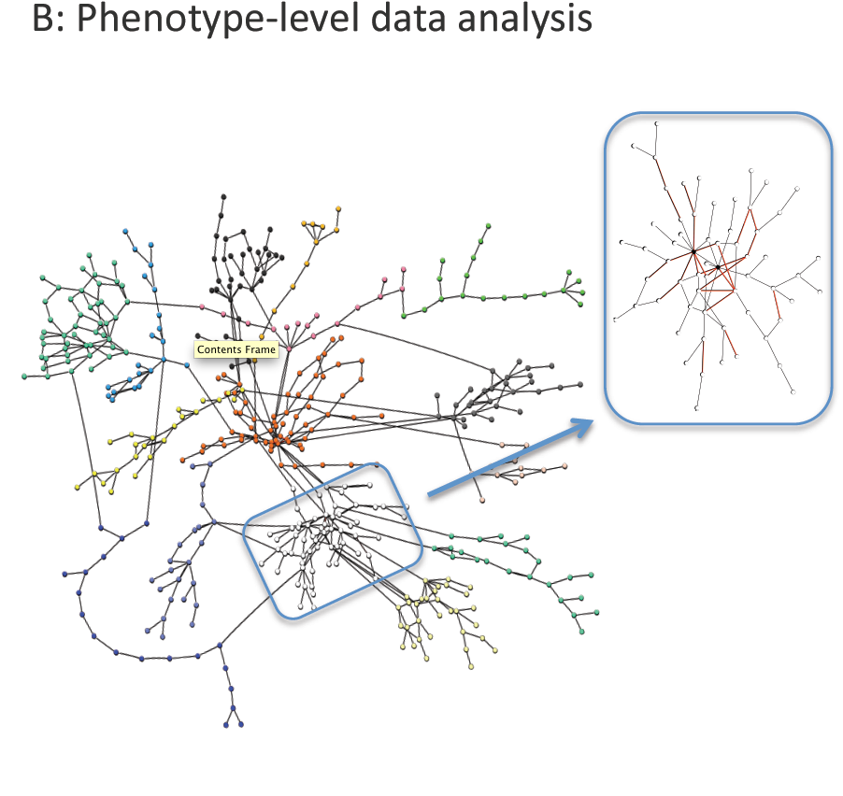
Listeria phylogenomics
Mapping selection to phenotype
Blue box identifies a module in the metabolic network.
Red links in the expanded view of this module indicate a significant cluster of genes subject to niche specific selection in “lineage I” of L. monocytogenes.
From Dunn et al 2009, MBE
Notes:
Cartographic model of the Listeria monocytogenes metabolic network.
Nodes are the substrates and products; lines represent genes (enzymes).
Node color represents module assignment. Only the GSC of the network is shown.
(B) Expansion of a single module (86) from the network for L.m- L1.
Red lines show genes subject to niche-specific selection pressure under H2 (L.m.-L1).

Slide 83
Multiple LRTs: scan of mammalian genomes
Kosiol et al (2008)

Slide 84
Multiple LRTs: scan of mammalian genomes
Kosiol et al (2008)
Dissimilarity measure:
Hierarchical clustering of GO categories (biological process)
over-represented with genes under positive selection

Slide 85
Which proteins are under positive selection?
Host proteins involved in defence or immunity against viral, bacterial, fungal or parasite attacks (MHC, immunoglobulin VH, class 1 chitinas).
Viral or pathogen proteins involved in evading host defence (HIV env, nef, gap, pol, etc., capsid in FMD virus, flu virus hemagglutinin gene).
Proteins or pheromones involved in reproduction (abalone sperm lysin, sea urchin bindin, proteins in mammals)
Proteins that acquired new functions after gene duplication.
Miscellaneous (diet, globins,etc. )

Slide 86
Conclusions

Slide 87
Detecting positive selection
Pairwise methods – very low power
Branch models allow variation over time but assume one ω for all sites - low power
Site models allow variation among sites but assume selection pressure does not change over time – have higher power if positive selection is long term
Branch-site models may be more successful at detecting episodic selection but are more difficult to fit, require more data and often have multiple sub-optimal peaks (caution with genome scans!)
Notes:
Originally codon models were developed with a focus on detecting positive selection.
However, since they represent a more realistic picture of protein-coding sequences, they should and can be used for many other purposes.
But since results depend on model definitions, this has to be better tuned.

Slide 88
Testing for positive selection
LRT is accurate even for small datasets
Power of LRT is better for larger datasets
Watch out for recombination
Accurate parameter estimation is more difficult, depends on model assumptions
Bayesian site prediction is even more difficult than LRTs and parameter estimation
There is an optimal window of sequence divergence (sequences should be not too similar and not saturated)
Robustness of results: Use several models & tests
Check for local optima, especially for complex models
Notes:
Originally codon models were developed with a focus on detecting positive selection.
However, since they represent a more realistic picture of protein-coding sequences, they should and can be used for many other purposes.
But since results depend on model definitions, this has to be better tuned.

Slide 89
Weaknesses of methods based on codon models
Model assumptions may be unrealistic (but some assumptions matter more than others)
The method detects positive selection only if it generates excessive nonsynonymous substitutions. It may lack power in detecting one-off directional selection or when the sequences are highly similar or highly divergent. Little power with population data.
Do not work for noncoding DNA (but see Wong & Nielsen 2003 Genetics)
Sensitive to sequence and alignment errors (Fletcher & Yang 2010 Mol Biol Evol 27; Privman et al. 2011 Mol Biol Evol 29; Jordan & Goldman 2012 Mol Biol Evol 29)

Slide 90
Criticisms on codon models
by M. Nei, Y. Suzuki, & A.L. Hughes
Hughes AL. 2007. Looking for Darwin in all the wrong places: the misguided quest for positive selection at the nucleotide sequence level. Heredity 99
Nozawa, Suzuki & Nei. 2009. PNAS 106
Yang Z, dos Reis M. 2011. Statistical properties of the branch-site test of positive selection. Mol Biol Evol 28
Zhai W, Nielsen R, Goldman N, Yang Z. 2012. Looking for Darwin in genomic sequences - validity and success of statistical methods. Mol Biol Evol 29
MacCallum, C. & Hill, E. 2006 Being positive about selection. PLoS Biol 4, e87

Slide 91
Input data
Anisimova and Liberles (2007)
Population level
Timeframe
of data divergence?
Species level
Use population
level tests
(DNA-level methods)
dS saturated?
Use codon methods
No
Allow variable
selective pressure?
Maybe
(distant lineages)
No
Yes
Use AA-level methods
Yes
Yes
Average dN/dS across sites & over time
3D?
Poisson random-field methods
Neutrality tests
CL approaches
dN/dS varies over time
dN/dS varies across sites & over time
dN/dS varies
across sites
Detecting combined
rate & conservation
Lineage- specific α-shifts
Structural approaches
Modeling heterotachy
Use 3D-structure
Results
Results
Cross-validation of results;
Additional analyses
to resolve discrepancies
Results

Slide 92
The many faces of codon models
Detecting selection
Studying codon bias
Inferring phylogenies
Dating speciation events
Ancestral reconstruction
Changes in time & space
Predicting coding regions
Improved alignment
Inferring gene features (phyloHMM, netHMM)
Simulation of data
Markov modulated model:
Guindon et al. 2004
Reviews of codon models:
Kosiol and Anisimova 2012
Anisimova and Kosiol 2009
Notes:
Originally codon models were developed with a focus on detecting positive selection.
However, since they represent a more realistic picture of protein-coding sequences, they should and can be used for many other purposes.
But since results depend on model definitions, this has to be better tuned.

Slide 93
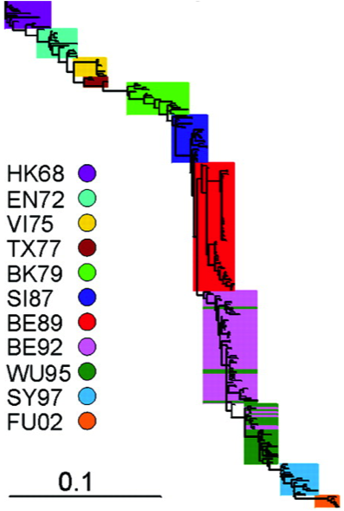
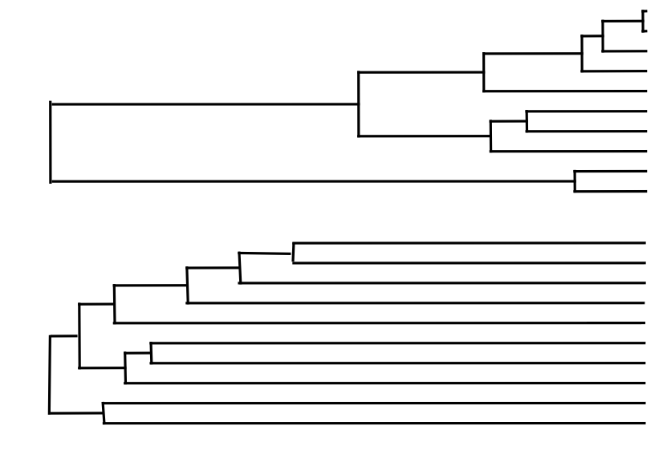
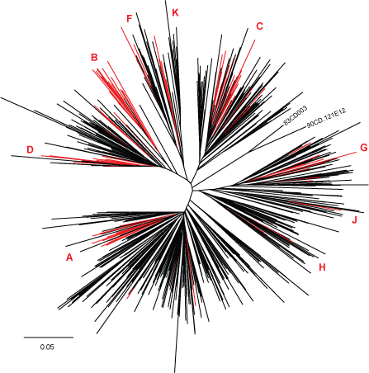
Selection affects the shape of tree
Influenza A
Smith et al. 2004 Science
Selection Neutral
HIV-1 subtypes
Archer, Robertson 2007, AIDS
Notes:
The only software offering such a variety of codon model, offers fast ML reconstruction with these models.

Slide 94

CodonPhyML :
maximum likelihood tree inference
Hundreds of codon models
Parametric, empirical, semi-parametric
Comparable likelihoods across AA, DNA, codon data
High performance computing
BLAS, LAPACK, OpenMP
Heuristic using exp(Qt) via Taylor
Blocking heuristic (FixQ)
Anisimova, Gascuel 2006 Syst Biol
Guindon et al. 2010 Syst Biol
Anisimova et al. 2011 Syst Biol
Gil et al. 2013 Mol Biol Evol
Notes:
The only software offering such a variety of codon models, offers fast ML reconstruction with these models.
M0 can incorporate this very effectively with only one omega parameter (constant selection over sites).
M3 (or less parameter rich variants like M5) can also help to account for positive selection at a fraction of sites.
We looked into this in more detail on mammalian data.

Slide 95
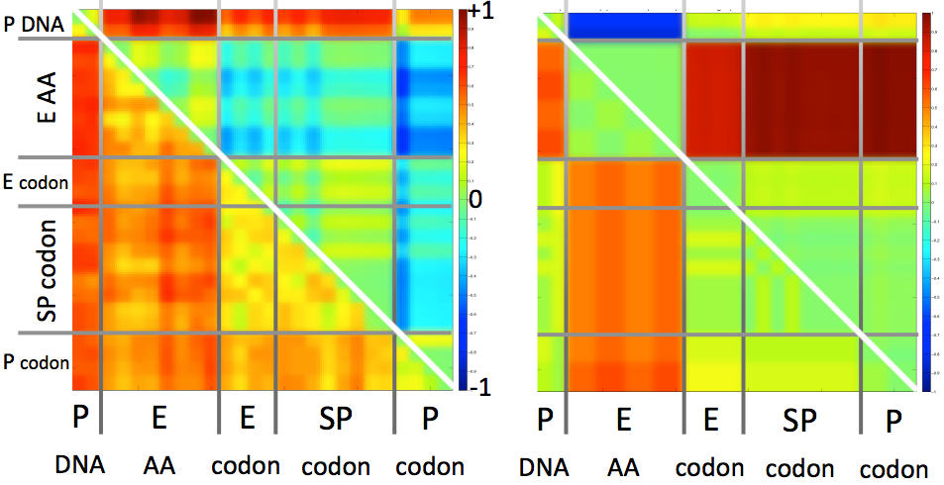
CodonPhyML:
Model & tree comparison on real data
Model types: DNA, AA, codon
E = empirical, SP = semi-parametric, P = parametric
Codon model fits worse:
Codon model fits better:
Better
(different)
Likelihood difference
(AICc)
Same
Tree difference
(RF distance)
Worse
Gil et al 2013, Mol Biol Evol
Notes:
The only software offering such a variety of codon model, offers fast ML reconstruction with these models.
PC=parametric codon models; EC= empirical codon models; SPC= semi-parametric codon models
The upper triangle shows the scaled AIC difference between vertical model and the horizontal one. Remember the smaller AIC the better it is.
Here we see a large red block indicating better fit of codon models over amino acid ones (for this particular dataset), with semi-parametric models providing a much better fit
In this case, even the DNA models fit better than AA models, but codon models still fit better than the DNA models.
SO using a codon model instead of a DNA or an amino acid model can significantly affect your phylogenetic inference.
Model selection is thus highly recommended.

Slide 96



CodonPhyML: evaluating inferred splits
correct
22 mammalian species
72 protein orthologs
wrong
Amino acid
model
Codon
model
Unpublished, Anisimova
aBayes support (Anisimova et al 2011, Syst Biol)
Notes:
Even in intuitively simple cases tree inference can be very hard.
In this example, it has been disputed whether a dog or a mouse is phylogenetically closer to human.
A dozen of papers, using different genes, taxonomic samples, and inference methods and models have been published and provide support for both scenaria.
A simple exercise shows that if only the orthologous genes from 4 species were analyzed, 37% of genes provide no information for either topology.
Setting apart many phylogenetic topic that concern this example, I will focus on methods that evaluate statistical branch supports of inferred clades.

Slide 97
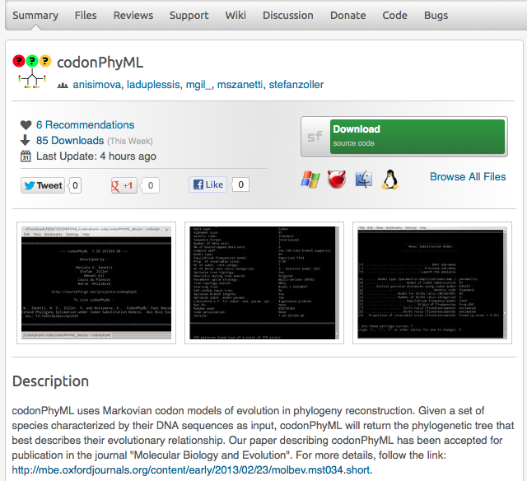

http://sourceforge.net/projects/codonphyml

Slide 98

Questions?

Slide 99
Remaining exercises
Focus:
ML estimation with branch-site models
Try out with codon tree (CodonPhyML)

